Slide 1
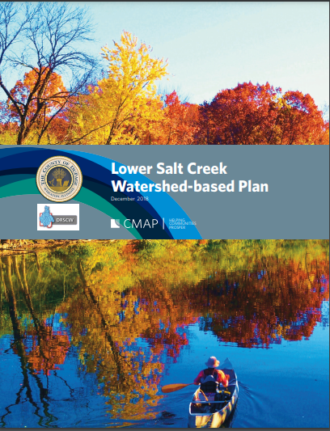
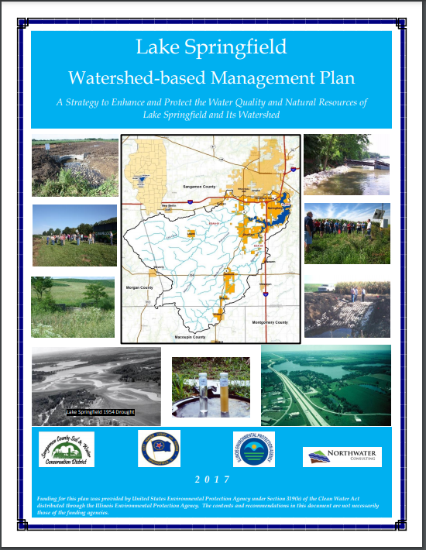
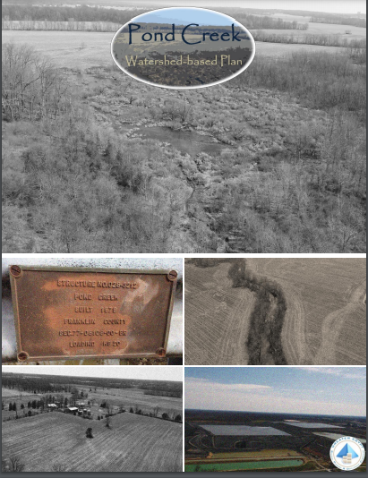
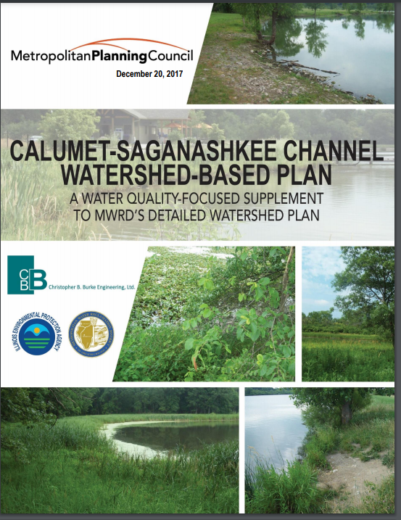
IEPA Financial Assistance Programs
Watershed Management and NPS Program Initiatives
Christine Davis
Illinois EPA
July 2021

Slide 2
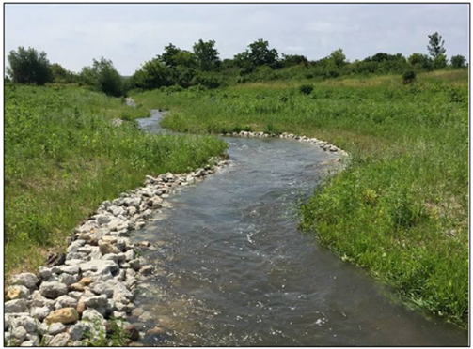
1) Section 319 Grant Program
Applications due by COB on July 30, 2021 TBD
Section 319
Location | Statewide/Priority Watersheds Watershed-Based Planning Areas
State Allocation | $3.6 Million
Grant Range | $20,000 - $1.2 Million
Maximum Grant | $1.5 Million
Minimum Match | 40 %
Project Length | Normally 24 Months
Eligible Projects Per USEPA (2013) | Watershed-Based Planning (WBP) or WBP Implementation (TMDLs Too!)
Practices | NPS Pollution Control BMPs *
Eligible Costs
Administration & Planning
Design & Engineering
Construction/Planting
Construction Oversight
Education/Outreach
Monitoring
* Excludes BMPs Required by State or Federal Law

Slide 3
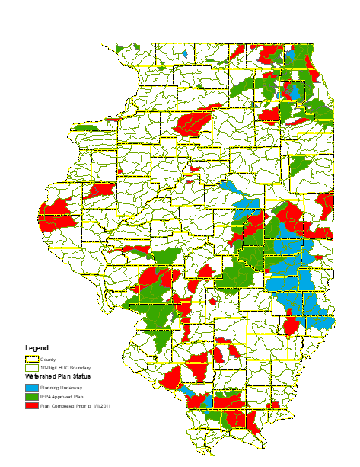
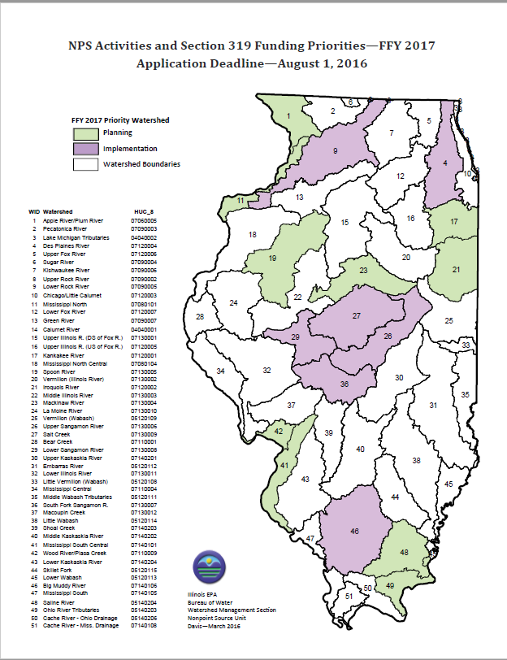

Section 319 Watershed Priorities
NPS Activities and Section 319 Funding Priorities – FFY 2022
Application Deadline – August 1, 2021
http://www.epa.illinois.gov/Assets/iepa/water-quality/watershed-management/Priority%20Watersheds%202016.pdf

Slide 4
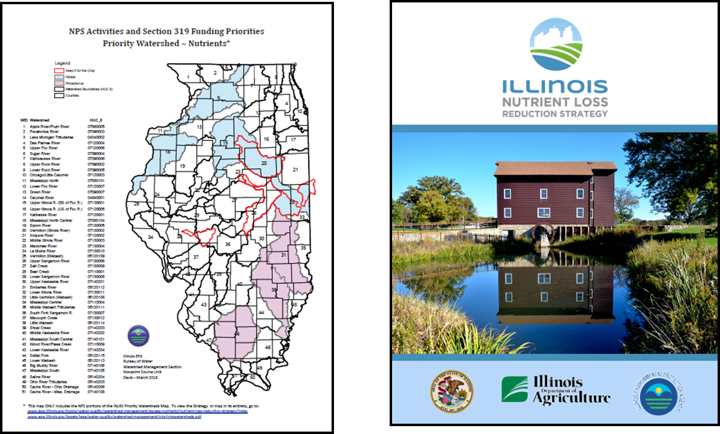
Section 319 Watershed Priorities - Nutrients
Priority areas do not guarantee funding.
Nor is funding limited to priority areas.

Slide 5

2) Section 604 Grant Program
Applications due by COB on January 15, 2022
Section 604
Location | Statewide
Number of Awards | 4
State Allocation | $375,000
Minimum Match | 0 %
Project Length | 24 Months
https://www2.illinois.gov/epa/Documents/epa-forms/water/financial-assistance/section-604b/section-604b-funding-opportunity.pdf#search=604
Example of Eligible Project Types
Watershed-Based Planning (WBP)
TMDL Implementation Plan Development
BMP Design/Engineering
Technical Assistance for Water Pollution Control
Outreach & Education
Environmental and Social Indicator Monitoring
Monitoring Projects Need a Quality Assurance Program Plan (QAPP) at the time of application.

Slide 6
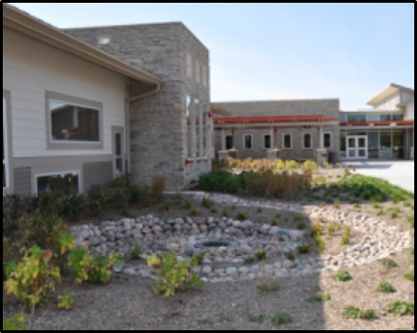
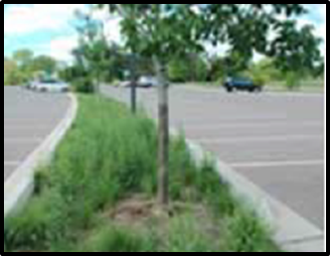
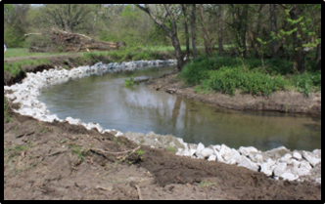
3) The Loan Program (AKA - State Revolving Fund)
Water Pollution Control Loans (WCPLC)
  Wastewater/Stormwater* Projects
Design and construction of a wide variety of projects for water quality in terms of human health and failing water infrastructure.

Slide 7

Stormwater-Related Projects that Benefit Water Quality (WPCLP)
*
Past ‘Normal’ Recipient was Local Government
    own, operate & maintain the assets
Projects (design and construction services)
    Green Infrastructure (rain gardens, streambank stabilization, permeable pavement & bioretention)
    Water and Energy Efficiency Improvements
    Other Environmentally Innovative Activities as Directed by Federal Law (check out 33 U.S. Code 1274 – Watershed pilot projects)
Loan Versus Grant – Think about it!
http://www.epa.illinois.gov/topics/grants-loans/state-revolving-fund/index

Slide 8
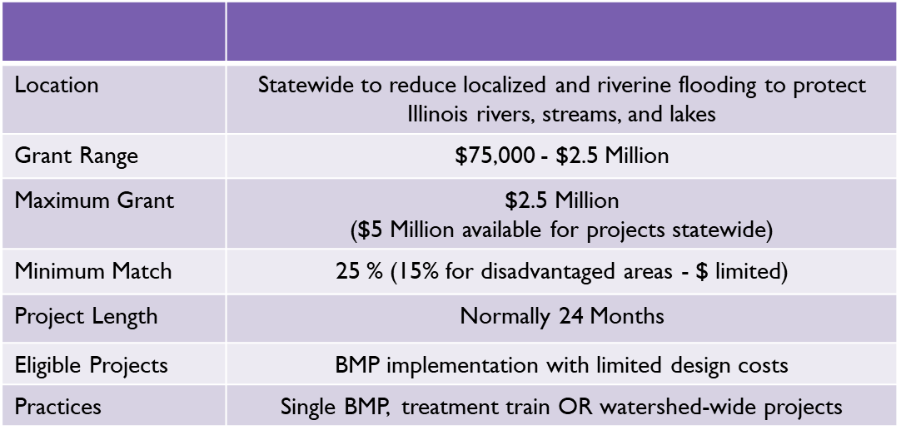
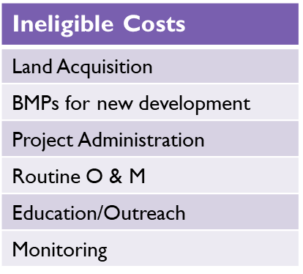
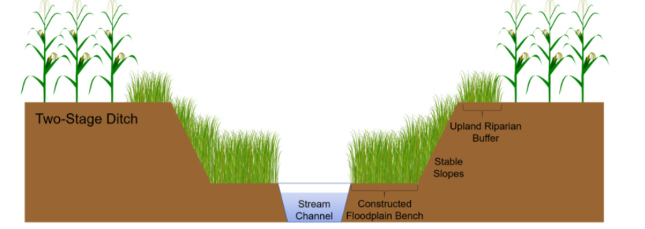
4) Green Infrastructure Grant Opportunities Program
Applications due by COB on TBD
GIGO
(Graphic courtesy of Brittany Hanrahan)

Slide 9
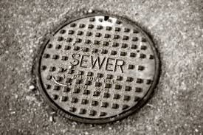
5) Unsewered Communities
Unsewered Communities Planning Grant Program
  Grant to develop a project plan to address collection and treatment of wastewater
Unsewered Communities Construction Grant Program
  Corrective actions for wastewater collection and treatment systems

Slide 10
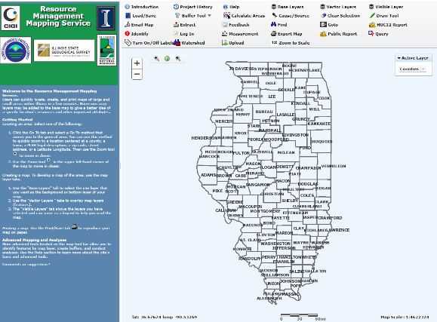
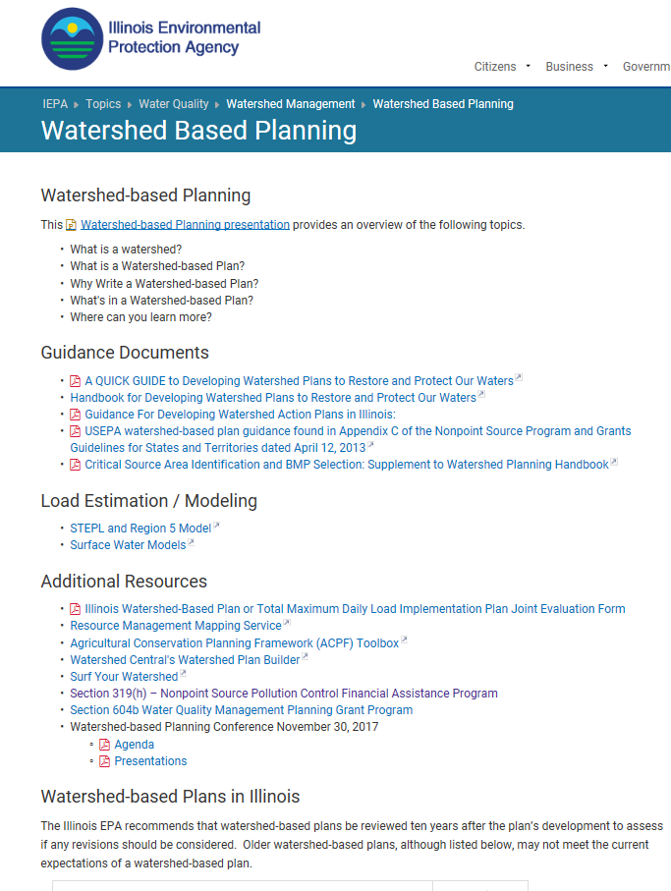

Resources Available
Call IEPA! We’re available to provide technical assistance.
Resource Management Mapping Service
http://www.rmms.illinois.edu
https://www2.illinois.gov/epa/topics/water-quality/watershed-management/watershed-based-planning/Pages/default.aspx

Slide 11
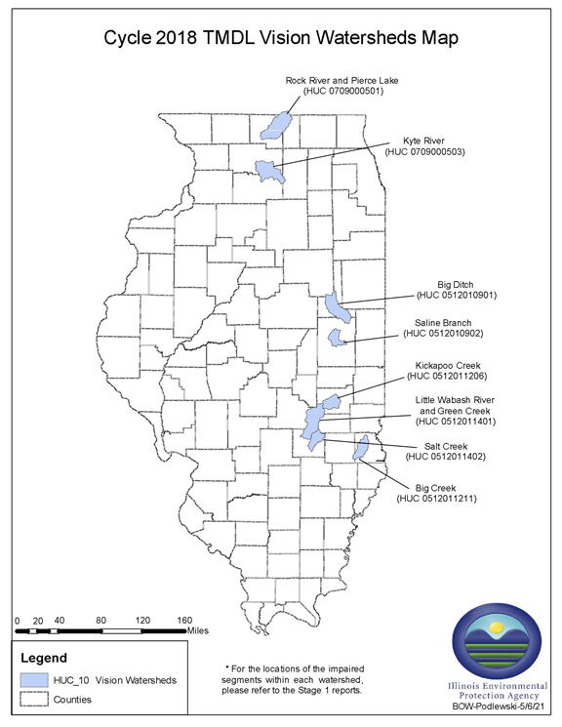
HELP US! Please
Total Maximum Daily Load (TMDL) Program
Illinois EPA contracts with consulting firms to develop TMDLs for impaired rivers, streams and lakes throughout Illinois.
SWCD’s have vital knowledge that when shared help develop the most cost effective and efficient AND IMPLEMENTABLE reports.
Please learn about the TMDL program, what reports are already complete in your District and provide information for the reports that are currently being developed.

Slide 12
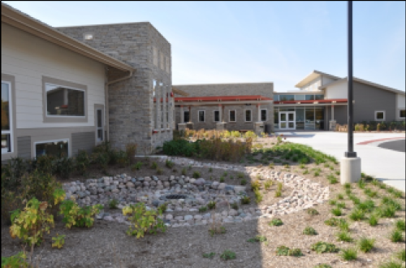
Questions?
Thank You!
Christine Davis
Nonpoint Source Unit
Illinois EPA, Bureau of Water
217.782.3362
christine.davis@illinois.gov
Early Childhood Center – DuPage County
BONUS SLIDES! Keep Clicking!

Slide 13
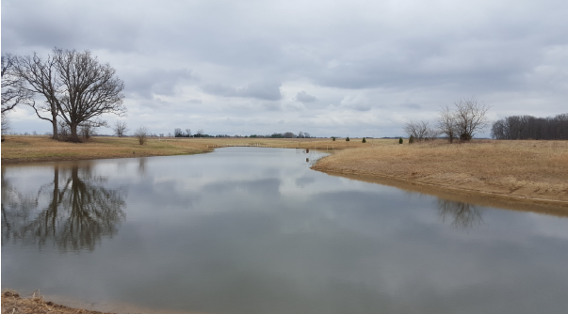
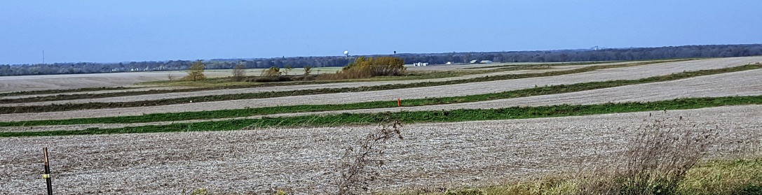
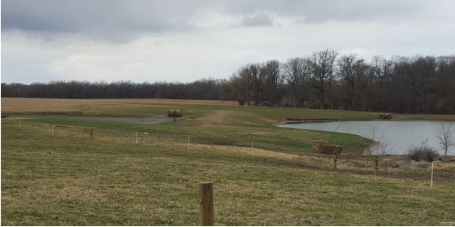
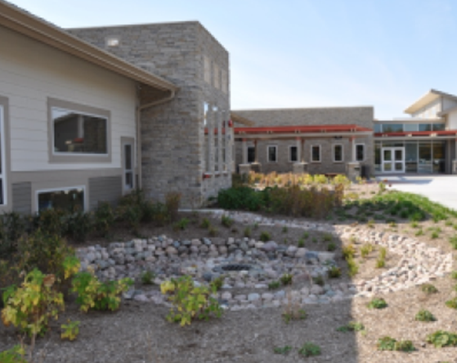
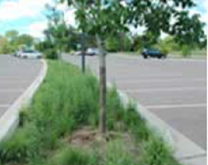
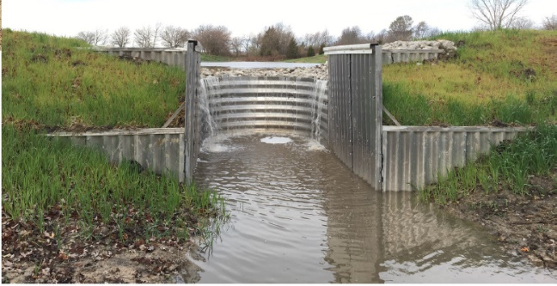
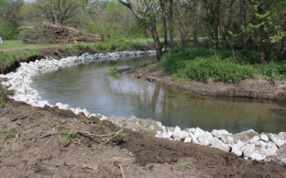
Best Management Practices
Ponds, terraces, grade control structures, rain gardens, permeable pavers & streambank stabilization for water quality.

Slide 14
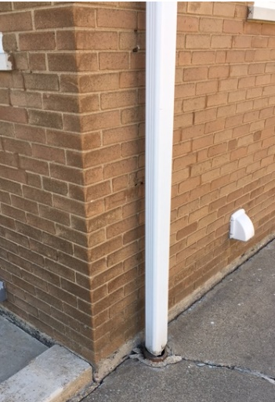
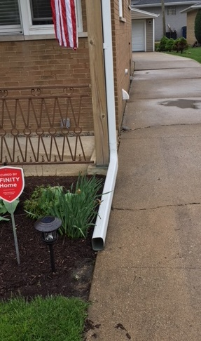
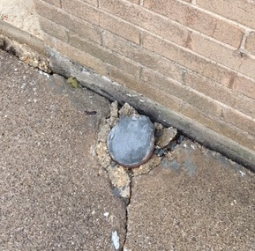
Downspout Disconnection Assistance Program
Village of LaGrange Park: Cook County
Funding Source: | Illinois Green Infrastructure Program (Program Currently Unfunded)
Date Completed: | November 30, 2018
Cost: | Total $274,593 | Grant $233,404 | Match $41,189
BMP Installed: | Downspout Disconnections, Rain Gardens, Bioswales, Dry Wells, Rain Barrels and Popup Emitters
Notables: | Village Ordinance w/Deadline to Disconnect Pilot Program for Seniors & Disabled Dedicated Project Manager Project Area was 2.25 Square Miles
Results: | 4,407 Downspouts Disconnected from 1,847 Homes (482 Home rcvd $)
Before:
47 % of Homes Connected to CSO, Contributing Roughly 12 % of the Flow During a Heavy Rain Event.

Slide 15
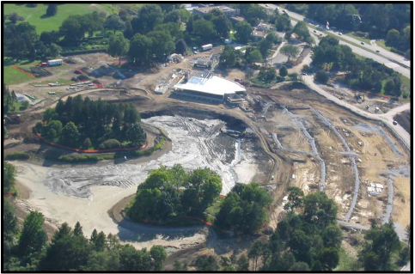
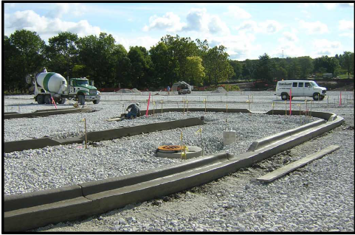
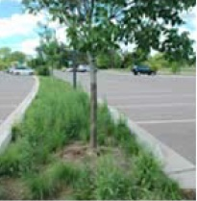
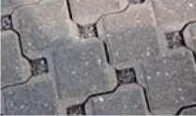
Morton Arboretum Parking Lot Runoff Control
Morton Arboretum: DuPage County
Funding Source: | Section 319 Grant Program
Date Completed: | January 2006
Cost: | Total $2,110,860 | Grant $1,266,516 | Match $844,345
BMP Installed: | Porous Pavement, Curb Cuts, Bioswales, 4’ Deep Gravel Drainage Layer, Level Spreader, Rock Outlet Protection, Filter Strip, and Wetland
Notables: | O & M: Periodic Vacuuming, no Grit or Sand for Winter Weather, De-icing Chemical OK on Pavement, but can Affect Plants and Water Quality. More Expensive to Install than Traditional lot, but can Save Money Over Long Run.
Results: | 6.4 acre Parking (489 cars and 11 buses) Non-pervious used in ADA Sections

Slide 16
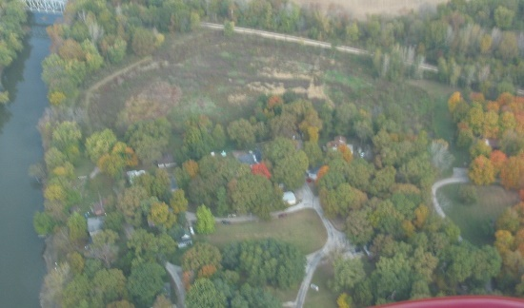
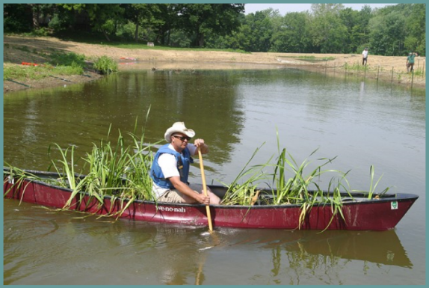
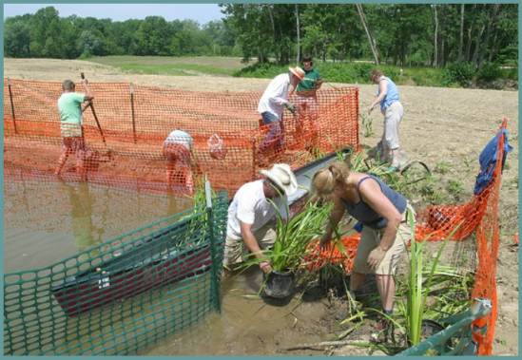
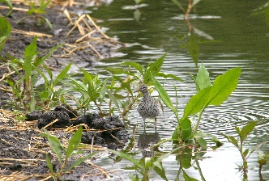
Old Salem Chautauqua Wetland Basin Project
Old Salem Chautauqua Homeowners Association: Menard County
Funding Source: | Section 319 Grant Program
Date Completed: | August 30, 2006
Cost: | Total $80,529 | Grant $20,000 | Match $60,529
BMP Installed: | Pond with Side Channel Outlet with 2 Wetland Cells
Notables: | Historic 6-acre Pond Constructed in 1926; Breeched in 1997 by Flash-Food. Investigation Found Drainage Area to be 725 Acres
Results: | 6.4 acre Pond with Stable Outlet/Overflow Channel, Sediment Load Reduction = 19 tons/year

Slide 17
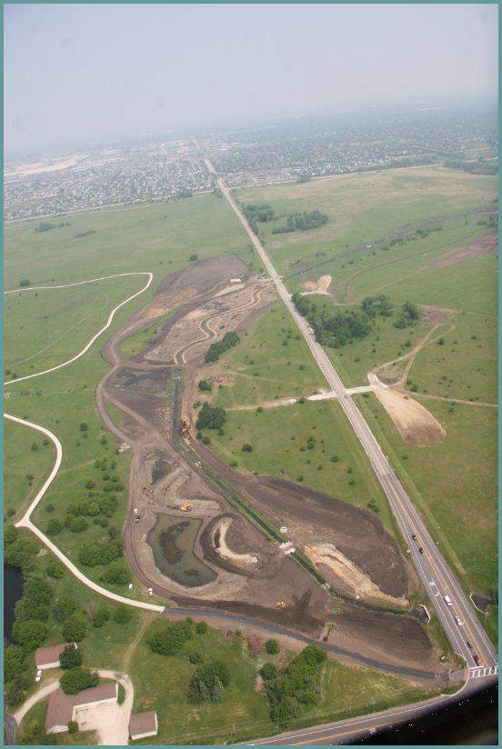
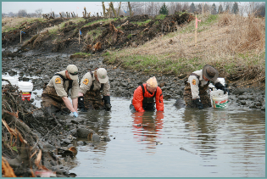
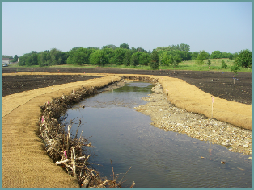
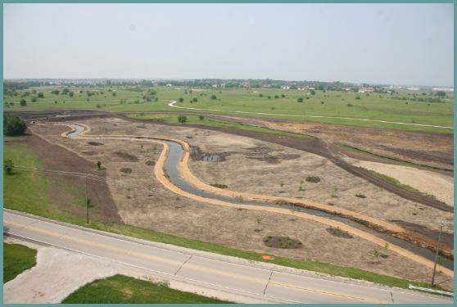
Springbrook Creek Stream Meandering
Forest Preserve District of DuPage County: DuPage County
Funding Source: | Section 319 Grant Program
Date Completed: | June 30, 2008
Cost: | Total $3.4 Million | Grant $1.2 Million | Match $2.2 Million
BMP Installed: | Stream Channel Remeander: Riffles, Rootwads, Cross Vanes, Buried Valley Sill, Side Channel Wetlands
Notables: | NEW STREAM CREATED Mimics Natural Features and Moves Llood Flows. Muscle Relocation. Uses Natural Material to Stabilize Bank and Improve Biotic Diversity
Results: | 10,990 LF of Stream Channel. Annual Load Reduction: Sediment = 3,237 tons, Phosphorus =1,619 lbs and Nitrogen = 1,619 lbs

Slide 18
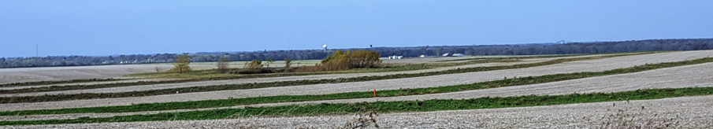
BMP Implementation ~ Be Sure to...
Secure Technical Assistance
Know BMP Operation and Maintenance Needs
Consider Upstream and Downstream of the Site
Secure Permits
Consider Potential Secondary Benefits (habitat, flooding)
Implement According to Designs (although change happens!)
Operate/Maintain the BMP Throughout its Lifespan
Promote the BMPs to Family, Friends, Neighbors, People You do Know, People You Don’t Know...

