Slide 1



AISWCD
Summer Training
July 14, 2021
1

Slide 2
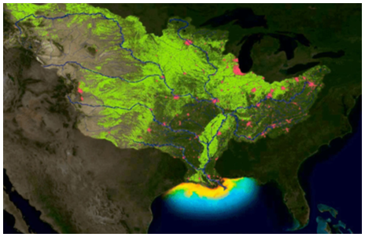
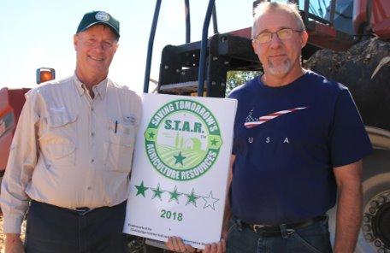

Why was STAR created?
Illinois Nutrient Loss Reduction Strategy of 2015
Two concerned farmers
Voluntary solution to local natural resource concerns

Slide 3
Why does STAR exist?
Conservation is now expected
Government and industry seeking solutions
Voluntary solution to local resource concerns
Bottom-up solution to measure conservation
Road map for conservation planning

Slide 4

What is STAR?
Evaluation
Verification
Recognition
Farmer-led FREE tool that is simple
Locally identified resource concerns
Based on practices on individual fields
Local technical assistance

Slide 5
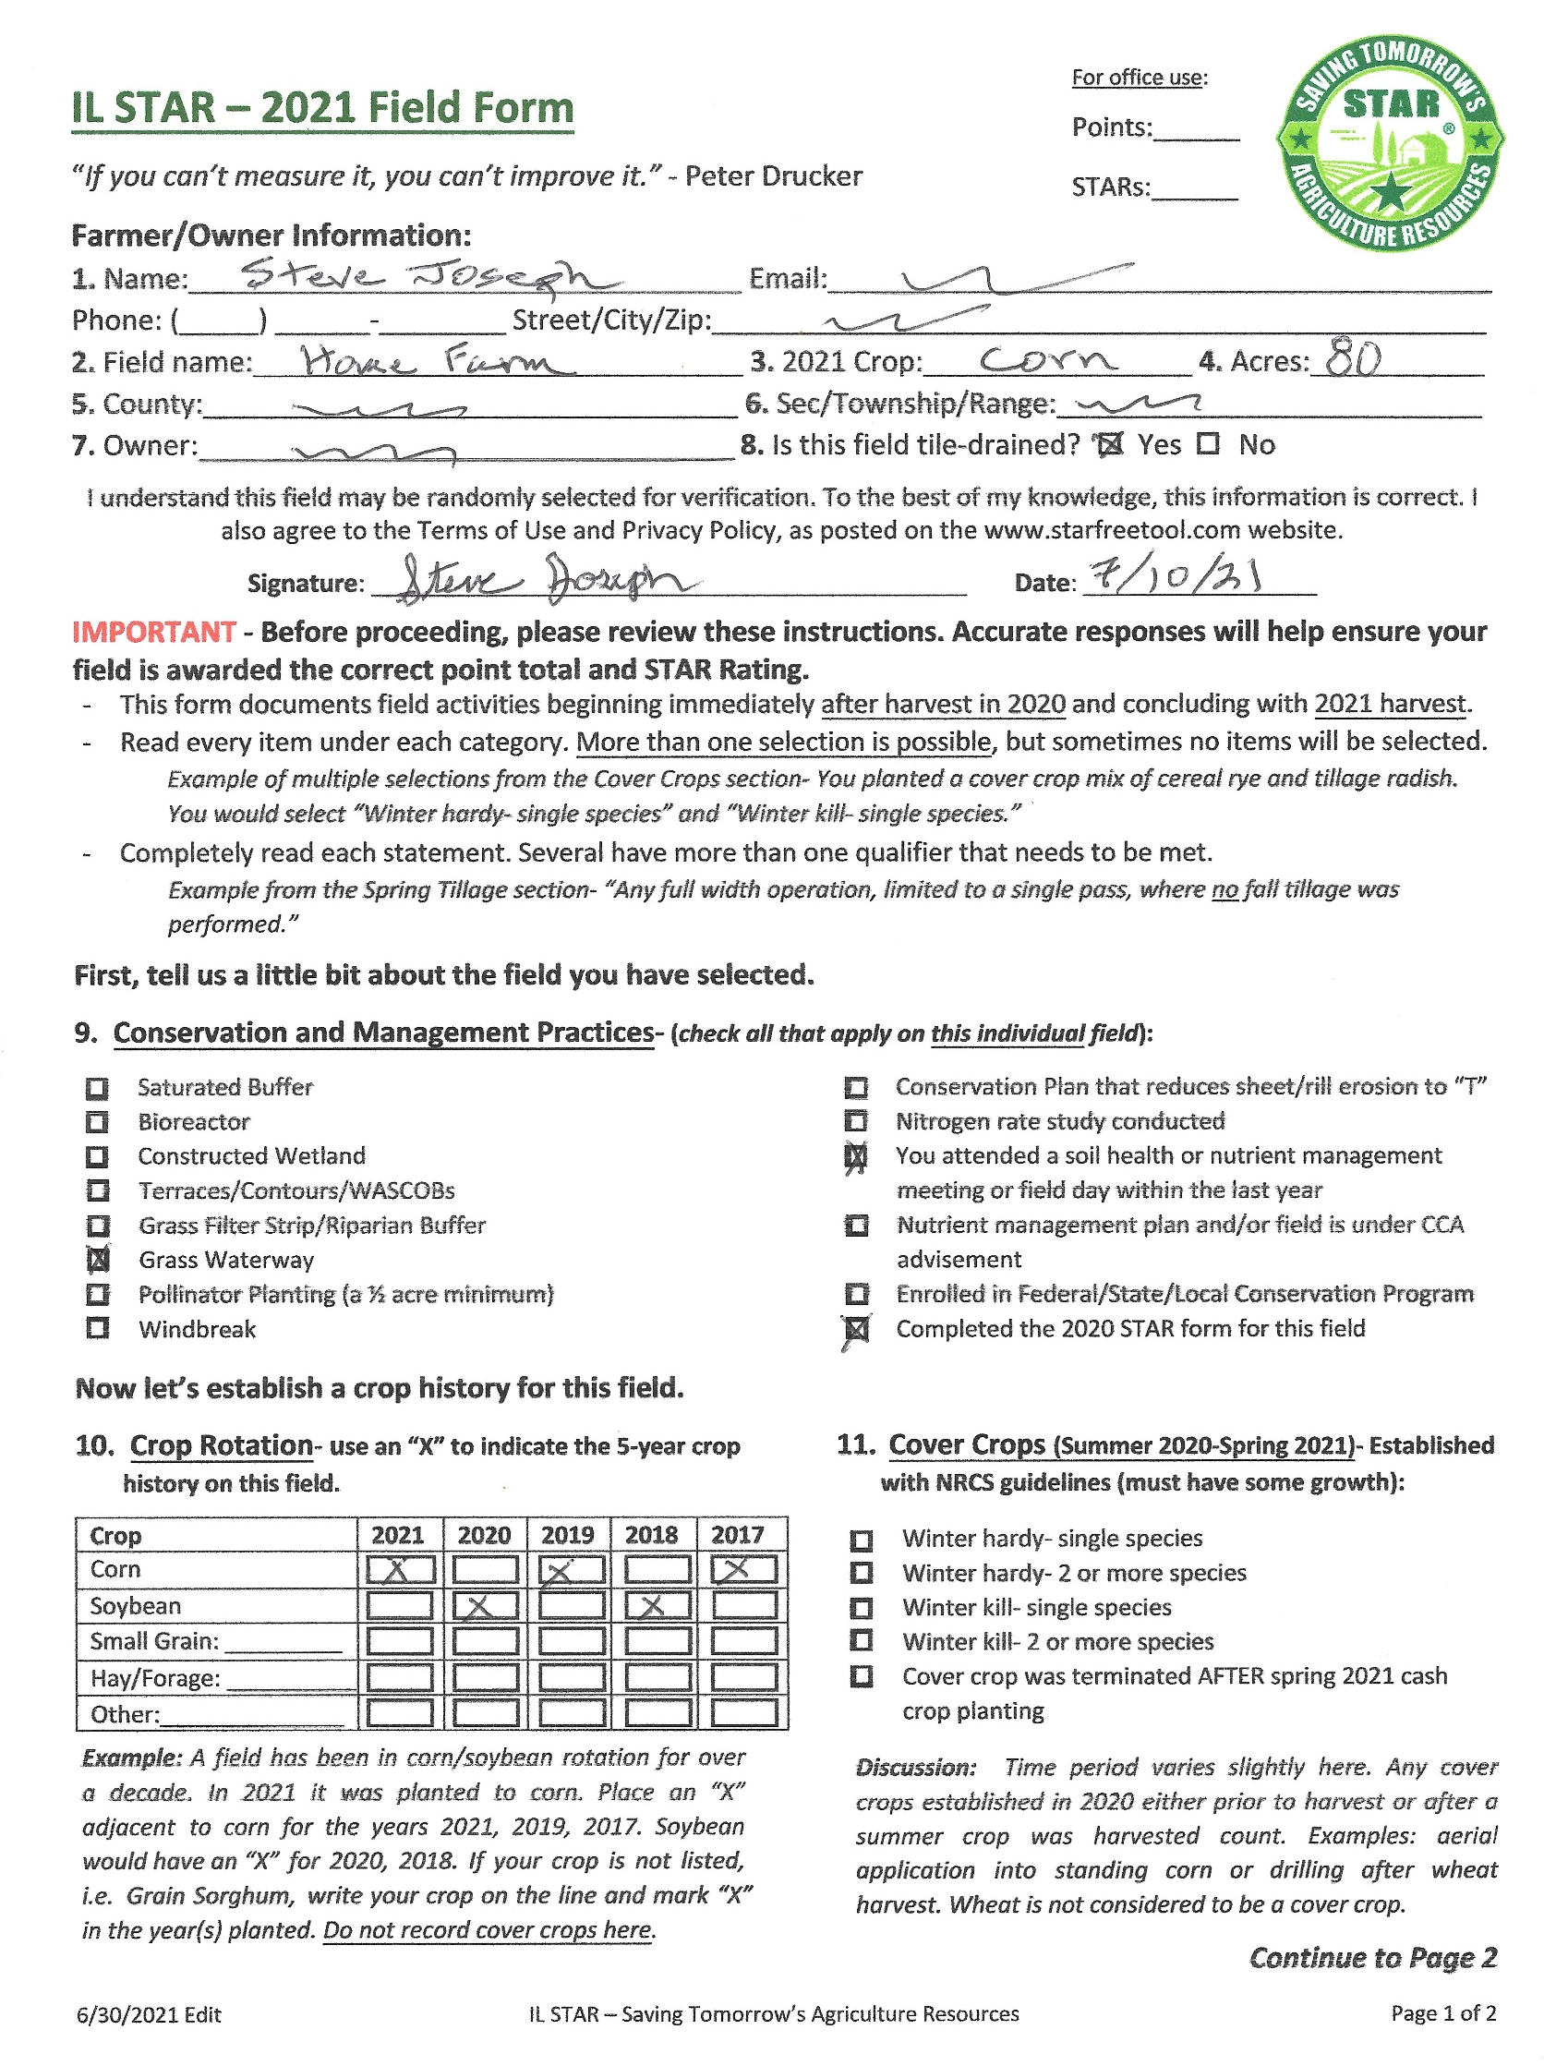
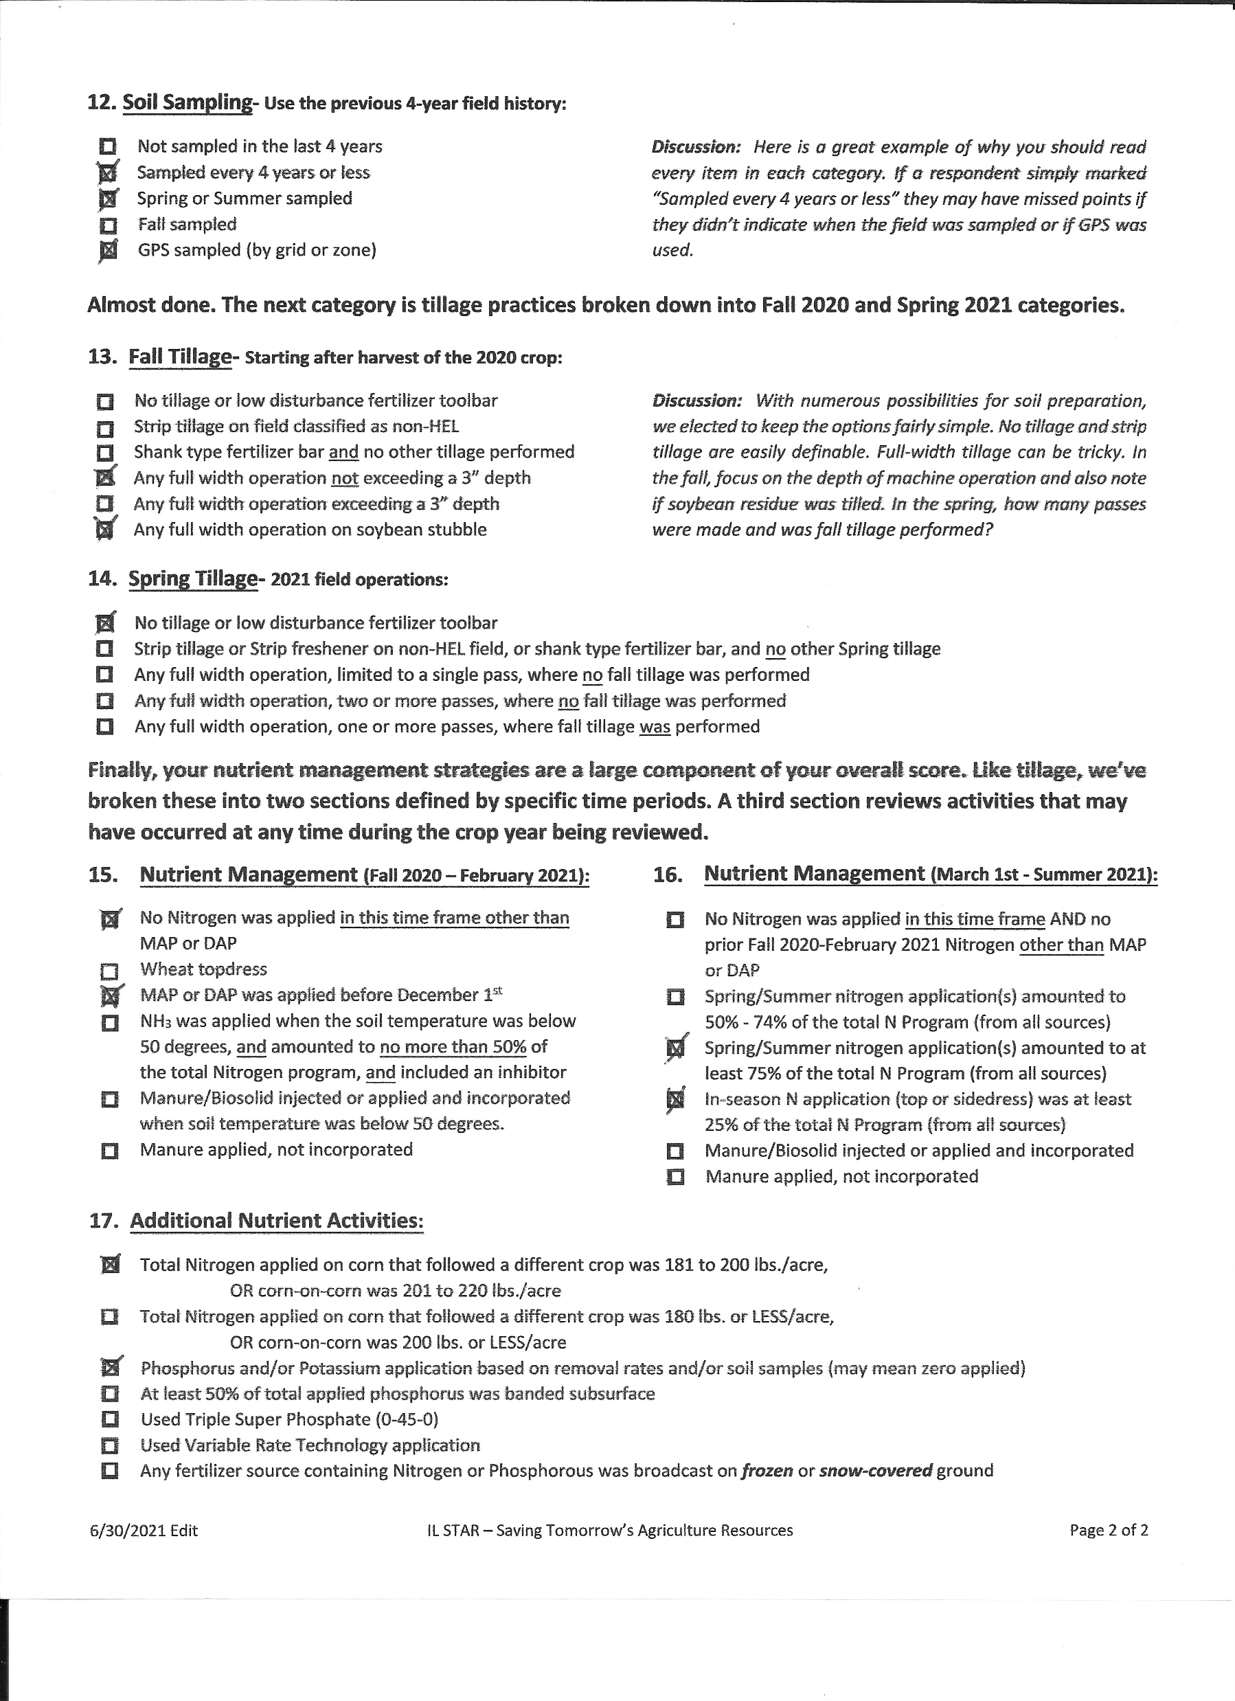
Evaluation
Simple Field Form completed for given crop year
Points assigned for each practice
Summary of points convert to a STAR Rating of 1-5 STARs.
Notes:
Include PWA

Slide 6
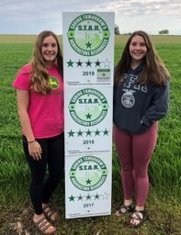
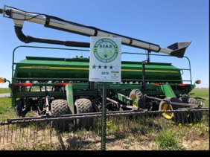
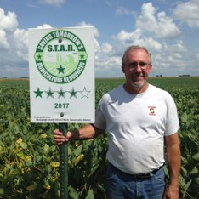
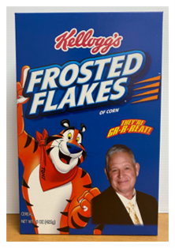
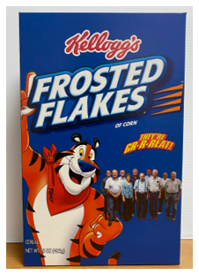

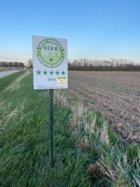
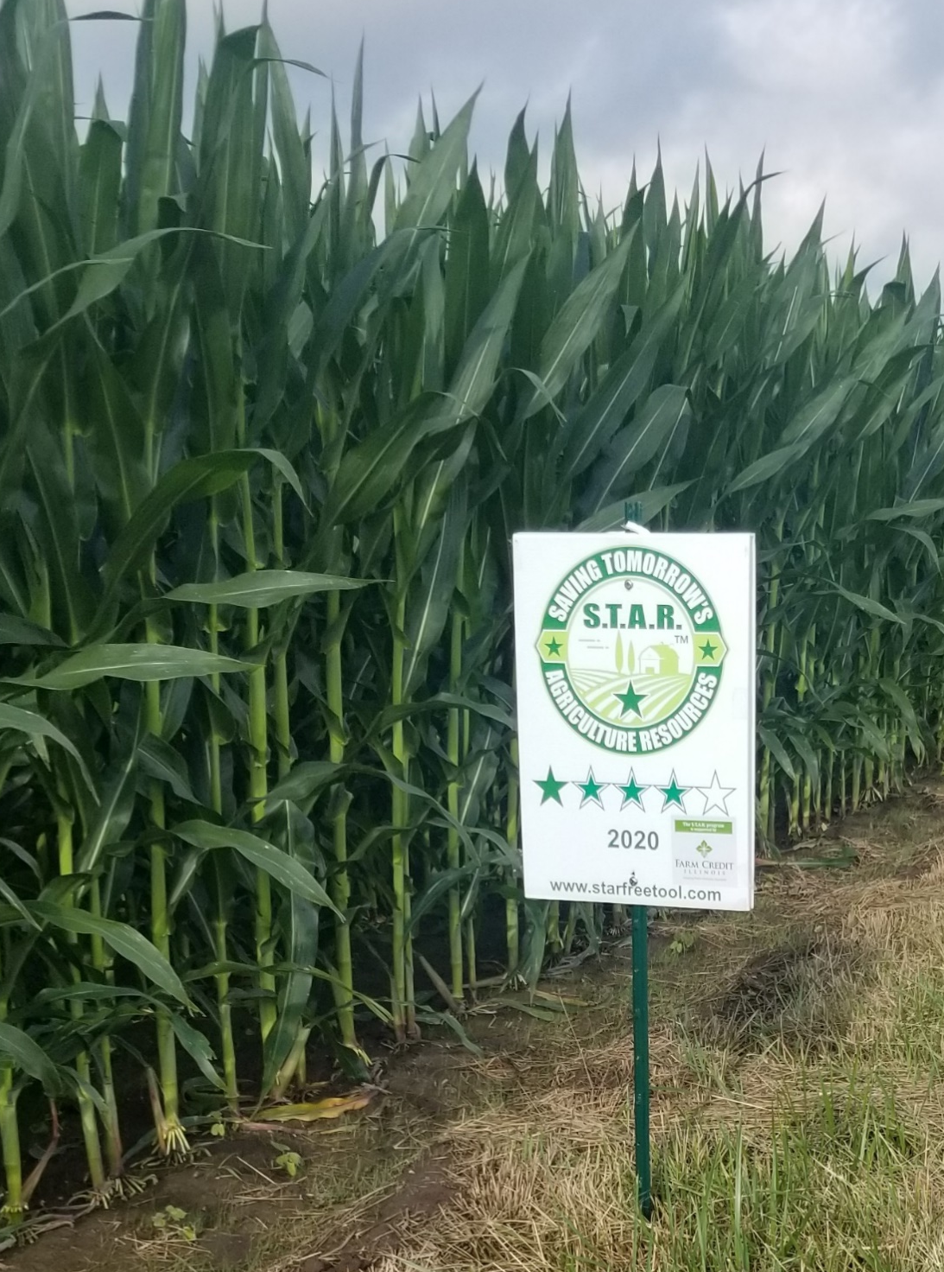
Recognition

Slide 7


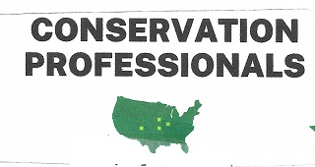




Slide 8

STAR Structure – Who Implements STAR?
Steps for those NOT licensed:
  Share information with Board of Directors
  Get agreement paperwork completed
  Steps once you are licensed:
  Establish admin account with Web App
  Promote STAR
  Review and score “standard” field forms submitted
  Provide technical assistance for those who want to increase STAR Ratings
  Submit data summary at end of the Crop Year

Slide 9
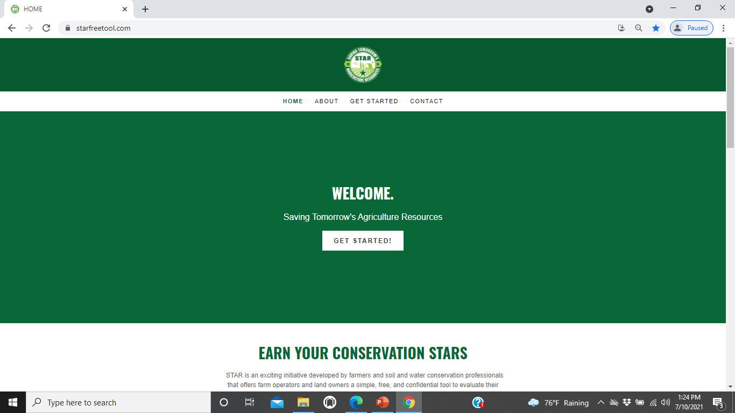
Go to www.starfreetool.com
1

Slide 10
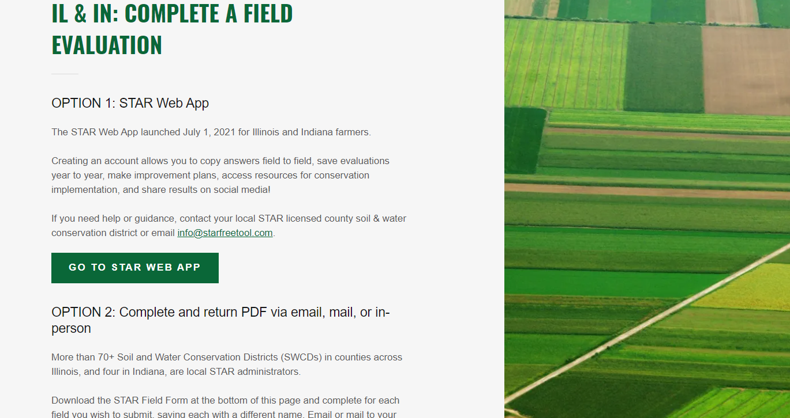
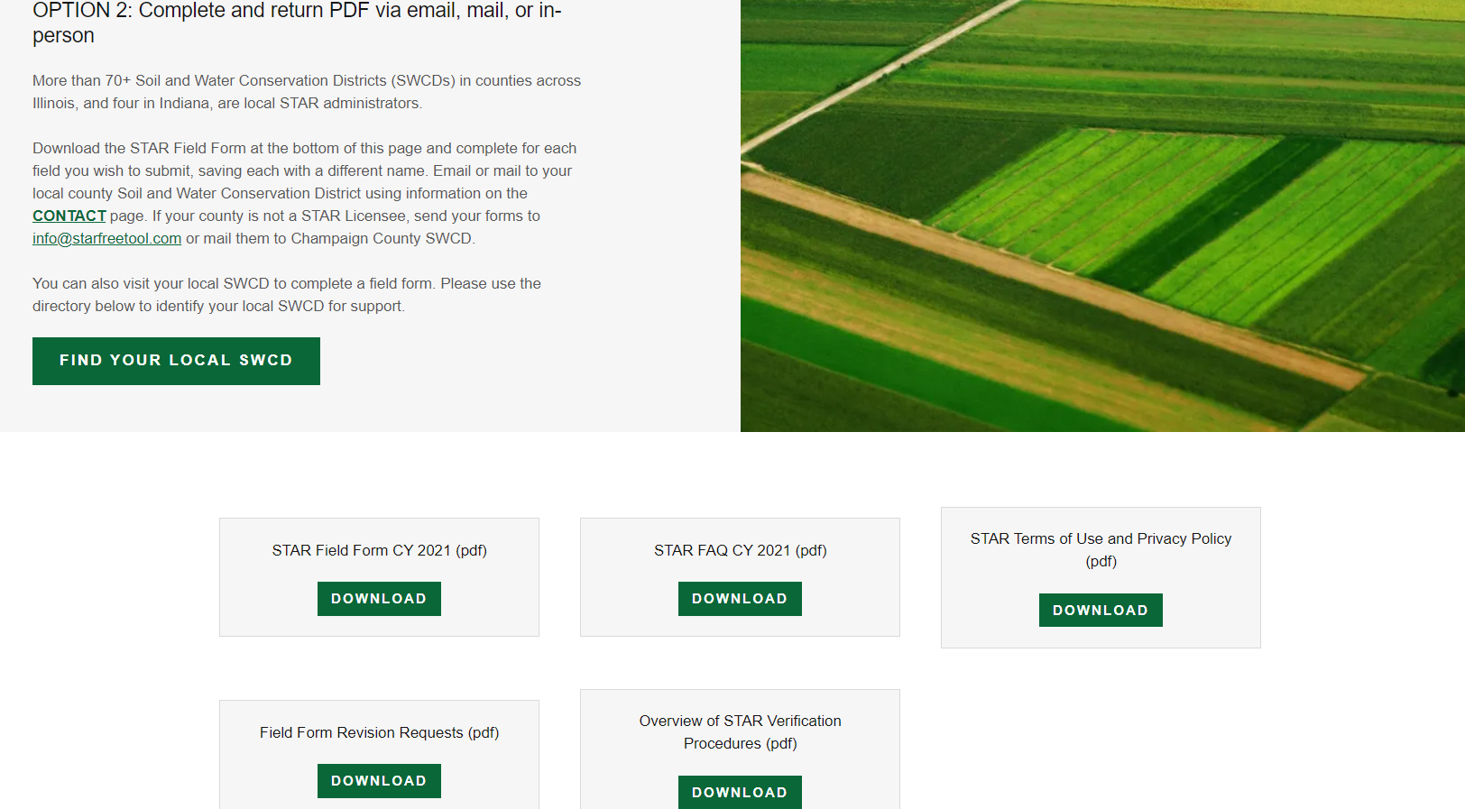
1

Slide 11

STAR 2021-Field Form
1

Slide 12
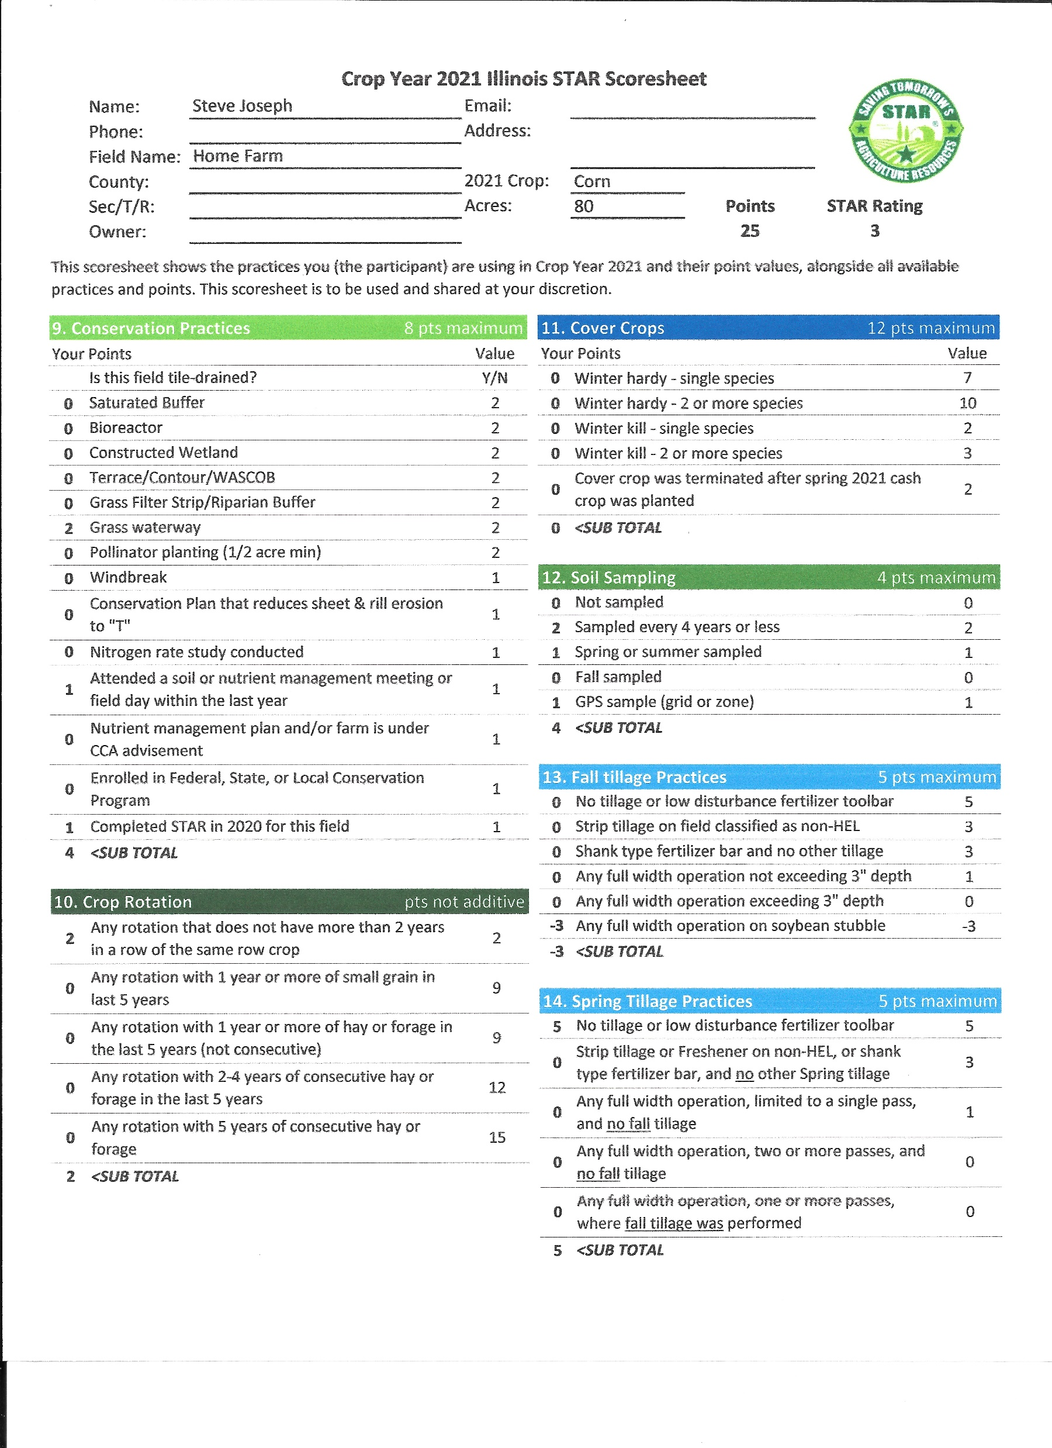
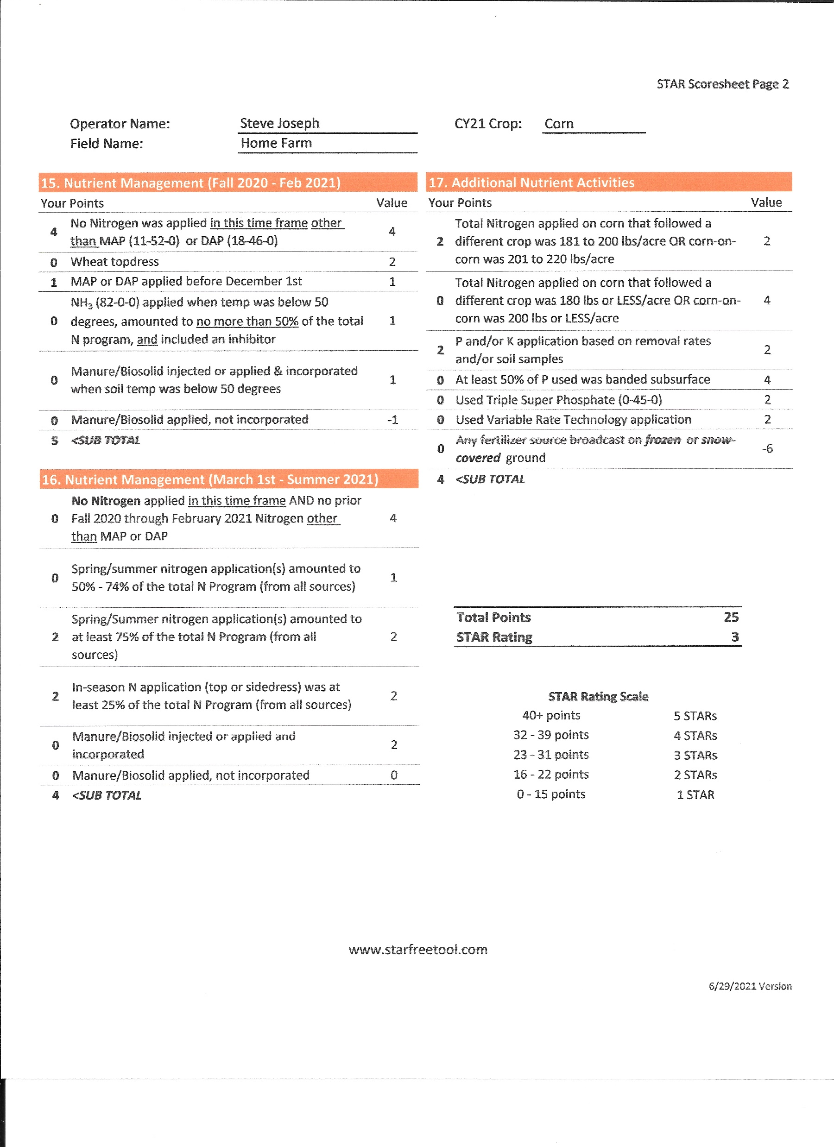
STAR 2021 - Scoring
1

Slide 13
1

Slide 14
1

Slide 15
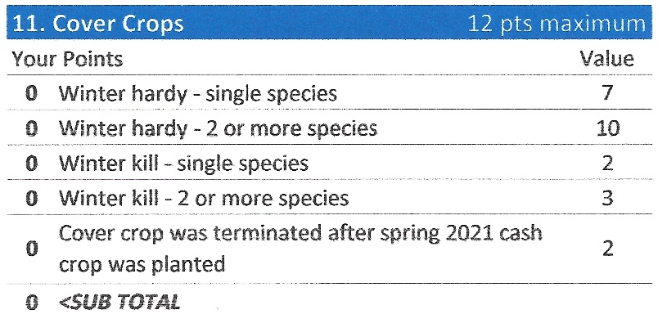
1

Slide 16
7
7
X
1

Slide 17
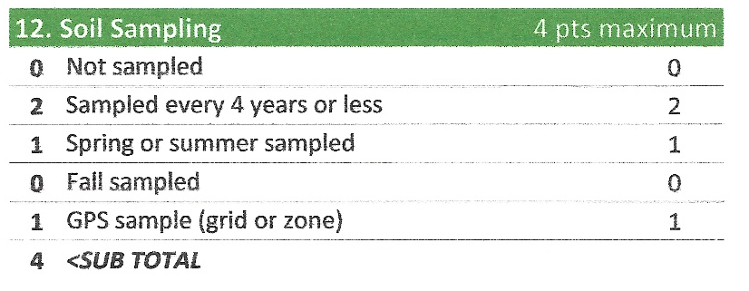

1

Slide 18
1

Slide 19
1

Slide 20

1

Slide 21
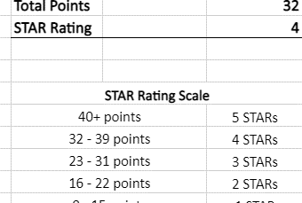
1

Slide 22
STAR Web Application access
Benefits:
Easier to use than standard field form
Automatically provides immediate scoring, STAR Rating, and
reporting at the end of the year
Provides an option for suggested changed practices
Friendly to use with a smart phone, tablet, or computer
Real-time access to county data, including the fields submitted and the practices being used
1

Slide 23
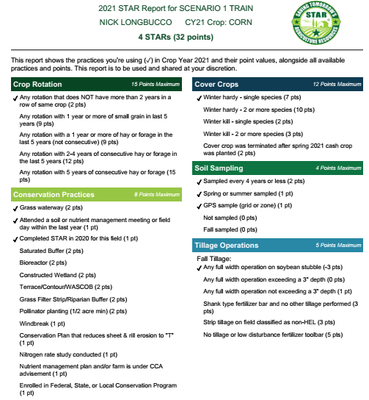
1

Slide 24
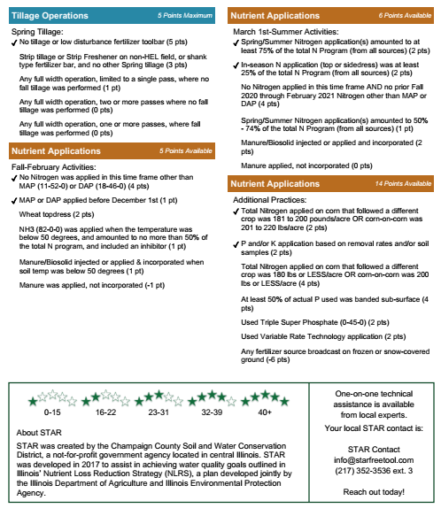
1

Slide 25


Questions, comments concerns?
More questions email Nick.Longbucco@AISWCD.org
Questions specific to the Web App – info@starfreetool.com
Star@ccswcd.com
@STARfreetool
@STARfreetool
StarFreeTool.com
Notes:
I am afraid that is all we got time for today. Great conversations and questions. If you have further questions you would like ask, please email me

